Slide 1


2019
Department
Of Computer
Science
&
Electrical And
Electronics
Engineering
MATH-IV
KAS -402
2020-2021
Dr.Rupa Sharma
Associate Professor
vsrsrsys@gmail.com

Slide 2


Slide 3
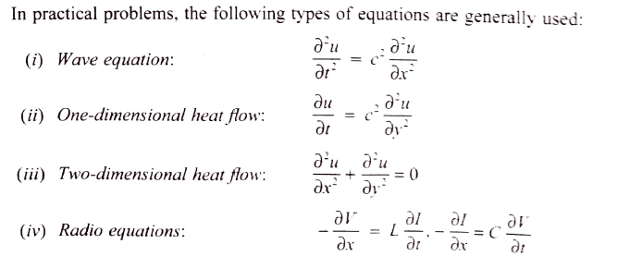

Slide 4
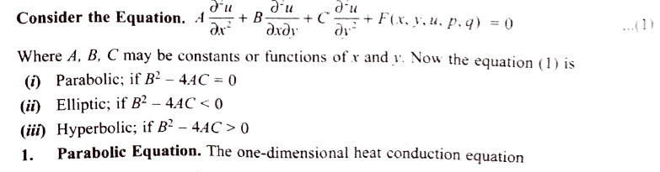
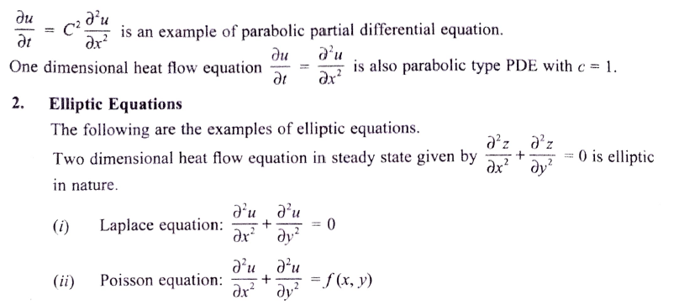

Slide 5
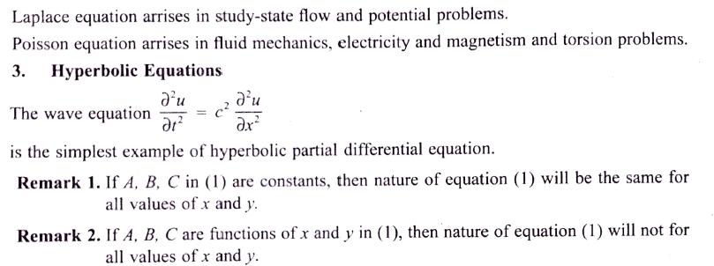

Slide 6
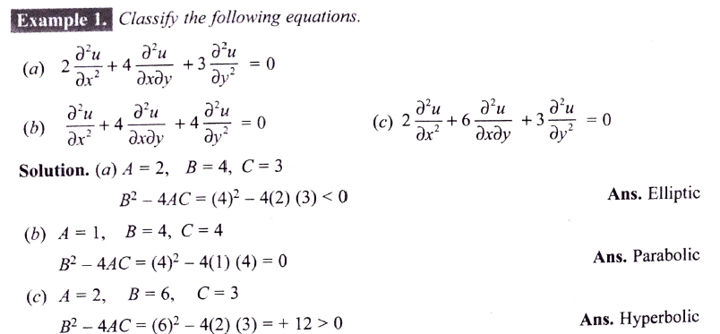

Slide 7
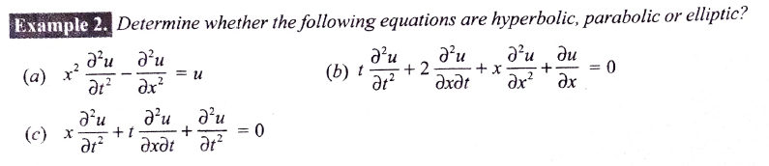
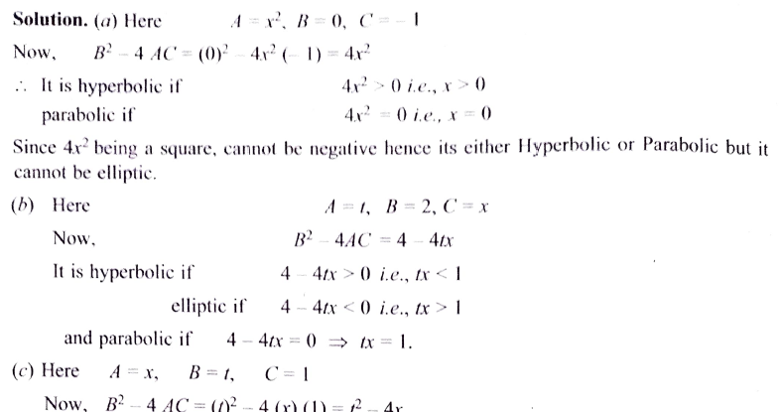

Slide 8
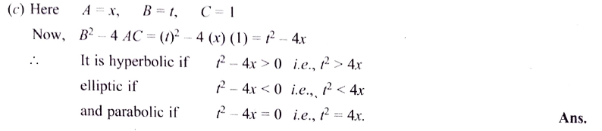


Slide 9
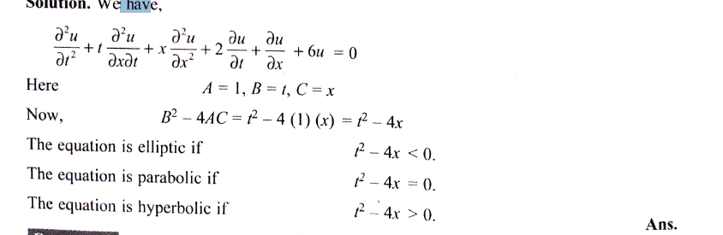

Slide 10


HOME WORK

Slide 11
THANK YOU

